Slide 1
A Brief Introduction to Machine Learning

Slide 2
AI VS Machine Learning

Slide 3
What is artificial intelligence (AI)?
Artificial intelligence is the capability of a computer system to mimic human cognitive functions such as learning and problem-solving. Through AI, a computer system uses maths and logic to simulate the reasoning that people use to learn from new information and make decisions.
https://azure.microsoft.com/en-au/overview/artificial-intelligence-ai-vs-machine-learning/#introduction

Slide 4
What is machine learning?
Machine learning is an application of AI. It’s the process of using mathematical models of data to help a computer learn without direct instruction. This enables a computer system to continue learning and improving on its own, based on experience.
https://azure.microsoft.com/en-au/overview/artificial-intelligence-ai-vs-machine-learning/#introduction

Slide 5
Relationship between them
While AI and machine learning are very closely connected, they’re not the same. Machine learning is considered a subset of AI.
An “intelligent” computer uses AI to think like a human and perform tasks on its own. Machine learning is how a computer system develops its intelligence.
https://azure.microsoft.com/en-au/overview/artificial-intelligence-ai-vs-machine-learning/#introduction

Slide 6
Why Machine Learning

Slide 7


Slide 8


Slide 9
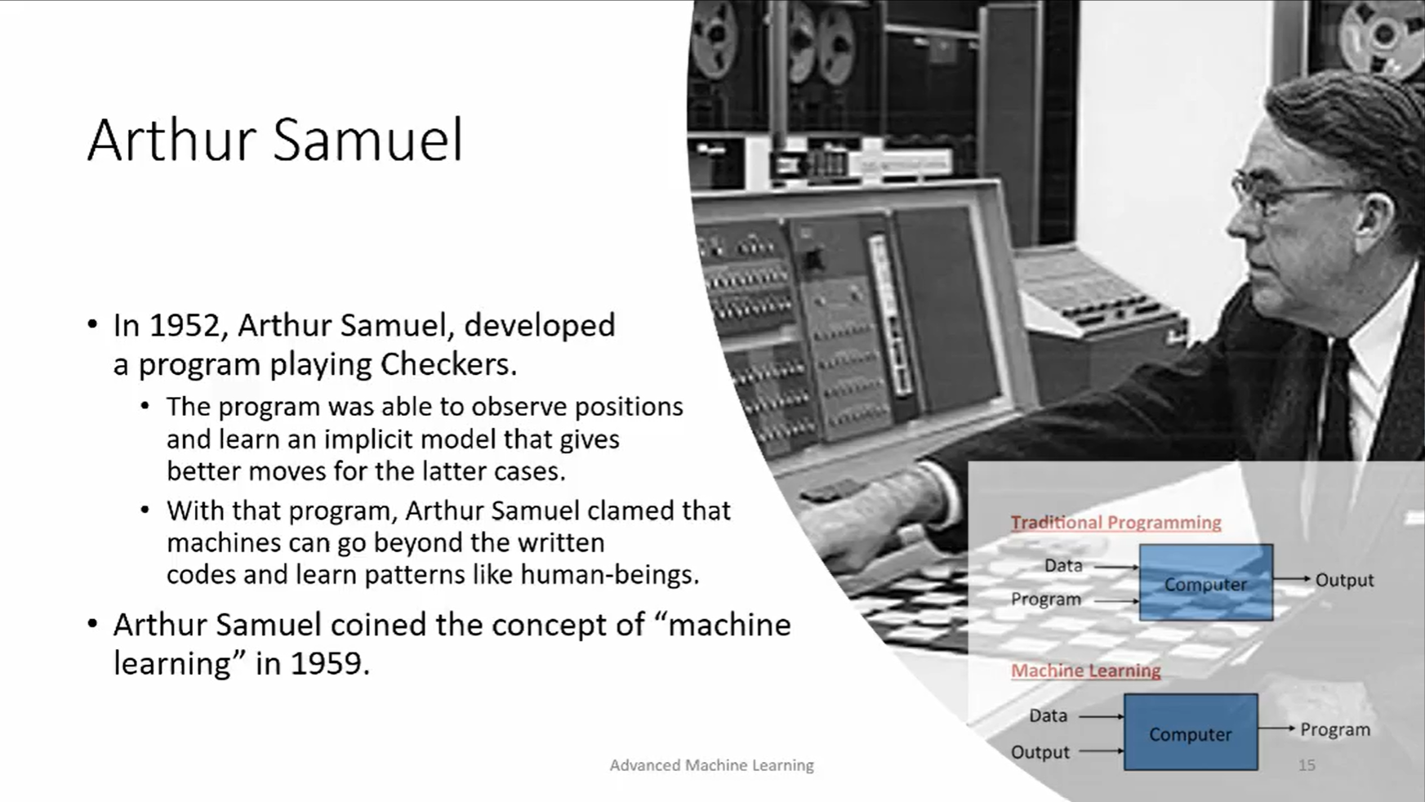

Slide 10
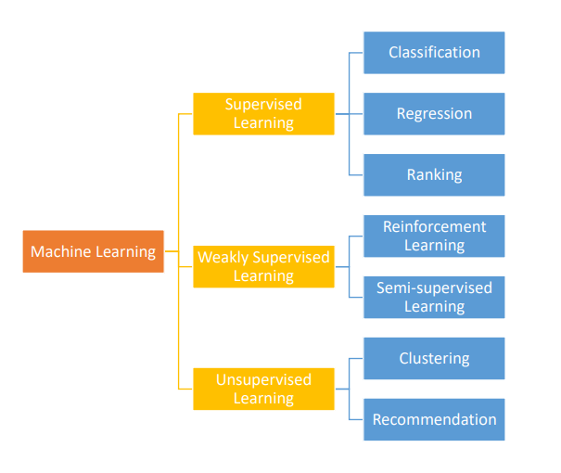

Slide 11
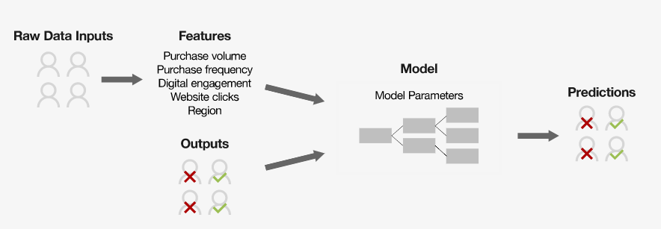
A typical Supervised Learning Pipeline

Slide 12
What is Deep Learning?

Slide 13
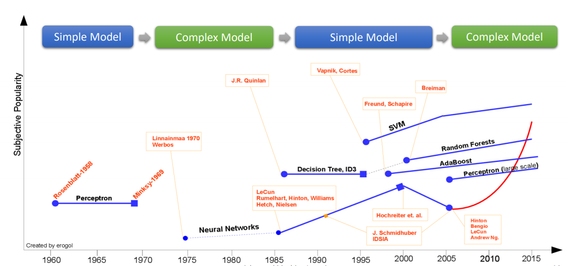
A Brief History of Machine Learning

Slide 14
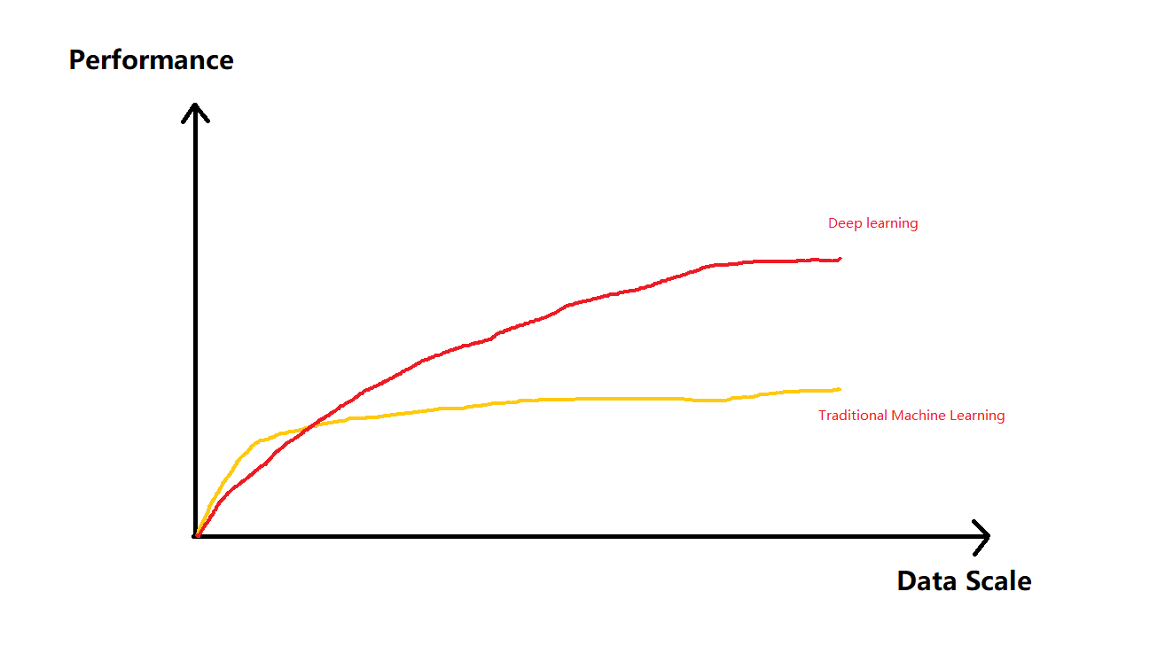

Slide 15
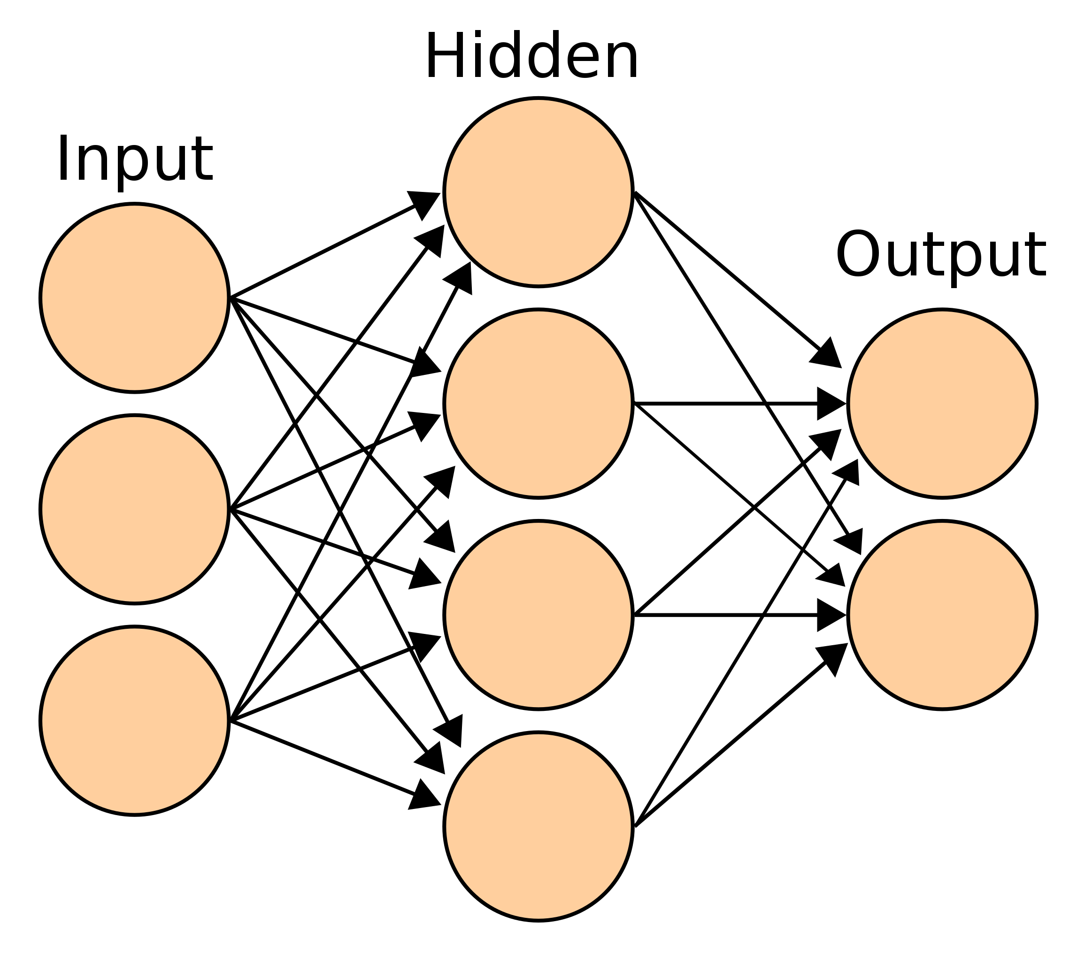
A simple network

Slide 16
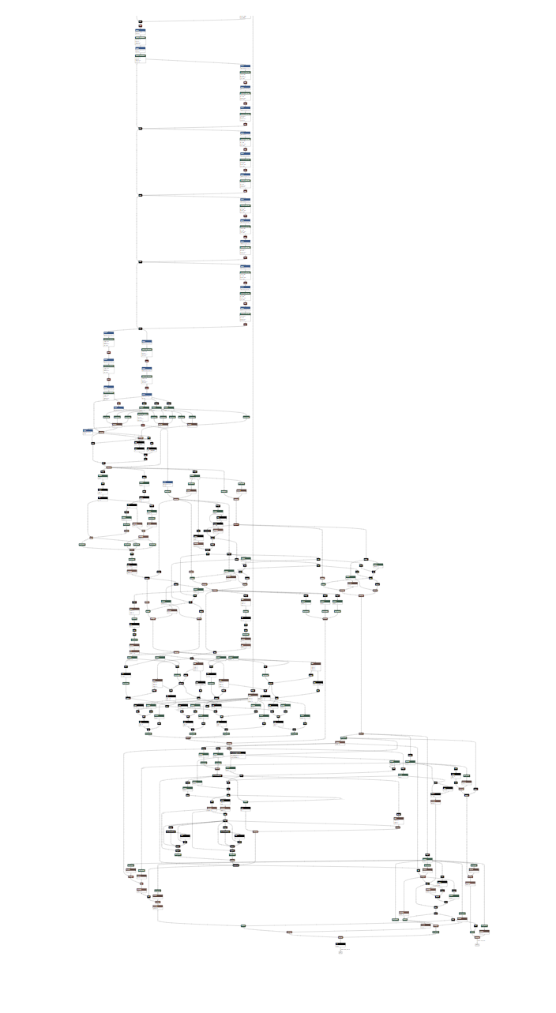
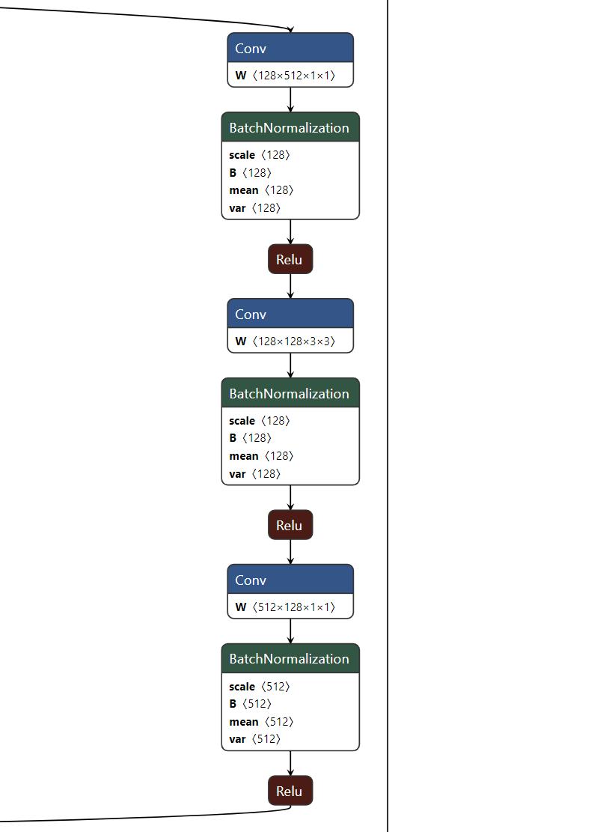

Slide 17

A famous research scientist from MSRA

Slide 18
A simplest model – Linear Regression

Slide 19

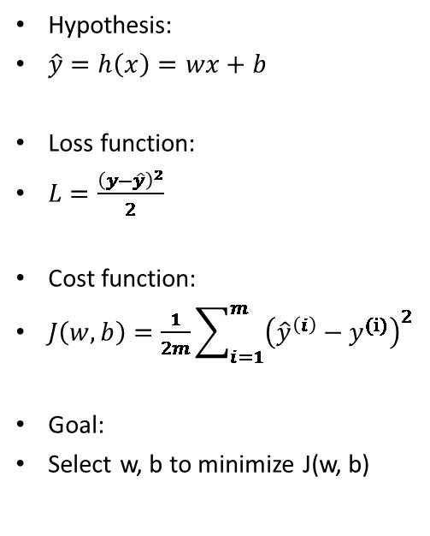
Model Definitions
Hypothesis:
$\hat{y}=h\left(x\right)=wx+b$
Loss function:
$L=\frac{{\left(y−\hat{y}\right)}^{2}}{2}$
Cost function:
$J\left(w,b\right)=\frac{1}{2m}\sum_{i=1}^{m}{{\left({\hat{y}}^{\left(i\right)}−y^{(i)}\right)}^{2}}$
Goal:
Select w, b to minimize J(w, b)

Slide 20

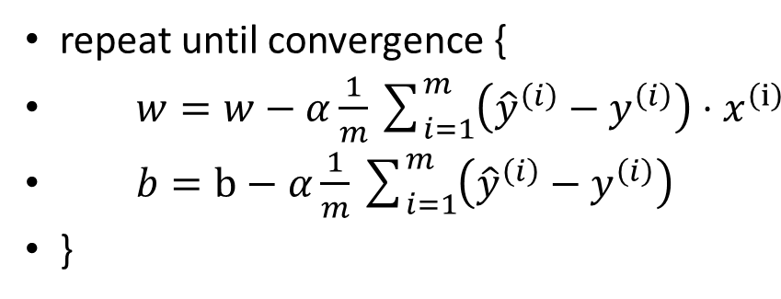
Gradient descent algorithm
repeat until convergence {
$w=w−α\frac{1}{m}\sum_{i=1}^{m}{\left({\hat{y}}^{\left(i\right)}−y^{\left(i\right)}\right)}⋅x^{\left(ⅈ\right)}$
$b=b−α\frac{1}{m}\sum_{i=1}^{m}{\left({\hat{y}}^{\left(i\right)}−y^{\left(i\right)}\right)}$
}

Slide 21

Technologies come and technologies go, but insight is forever.
http://neuralnetworksanddeeplearning.com/index.html

